Slide 1
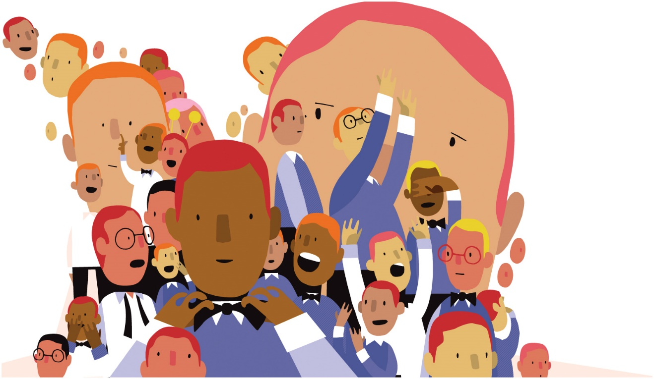
Socialization
Ms. Kauser Malik
Lecturer (Sciences & Humanities)

Slide 2
Learning Objectives
Understand the importance of socialization both for individuals and society
Explain the nature versus nurture debate
Major Agents of Socialization, learn the roles of families and peer groups in socialization, understand how we are socialized through formal institutions like schools, workplaces
Understanding Resocialization, explain how socialization occurs and recurs throughout life

Slide 3
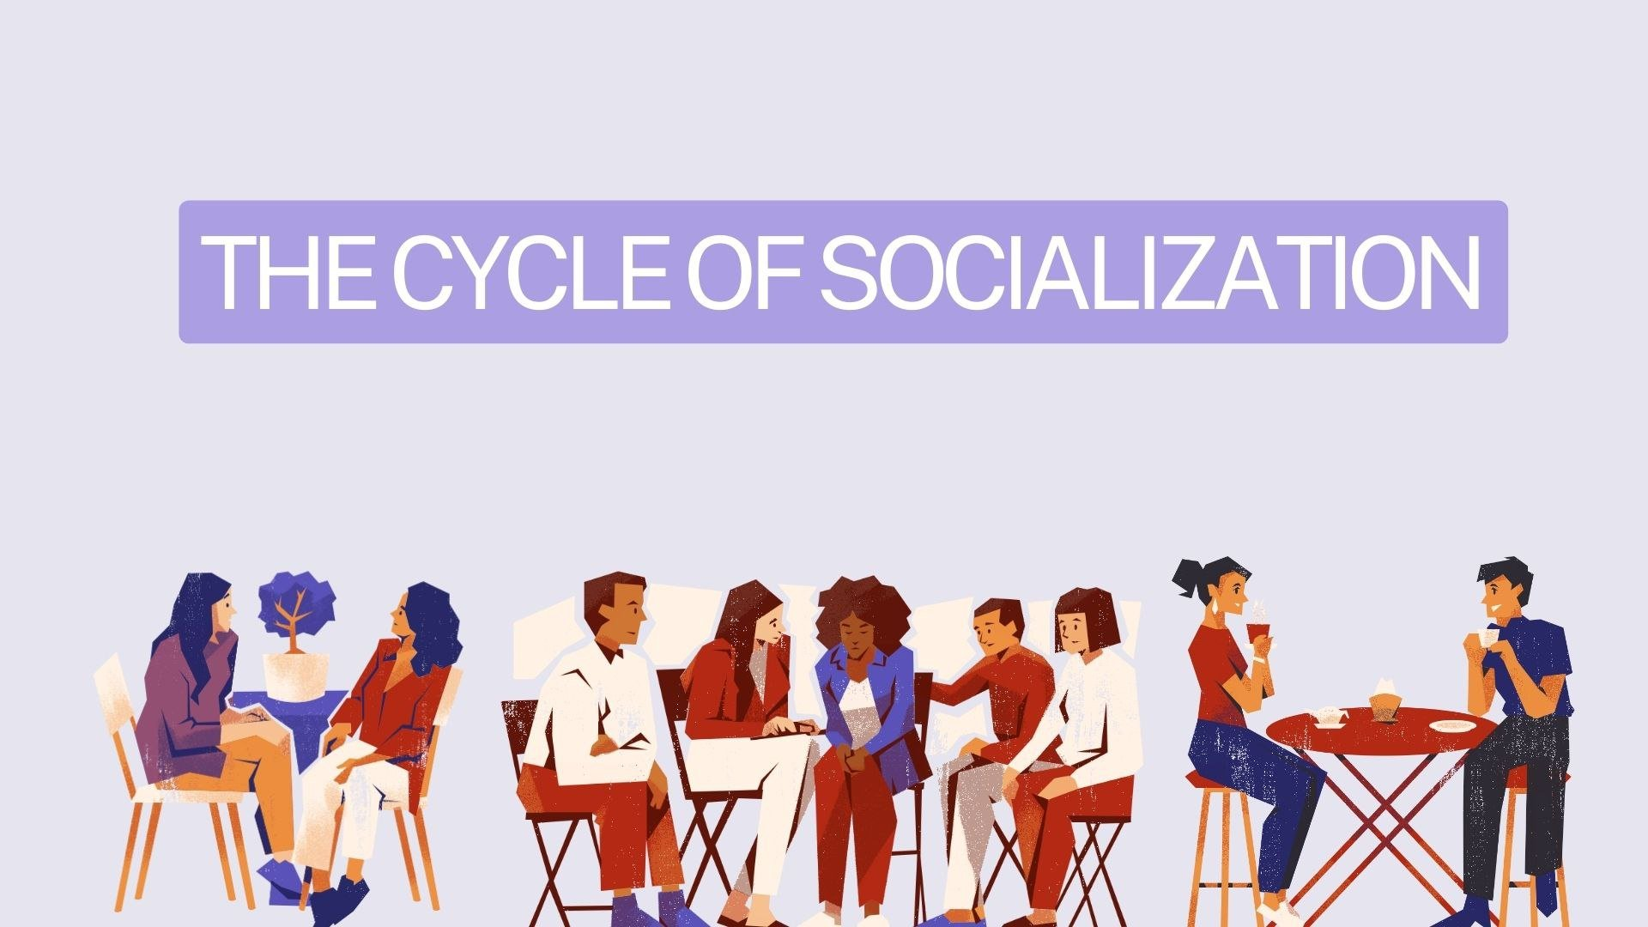
Socialization
The process by which an individual learns how to interact with others and becomes a member of society. It is a complex, lifelong process.
It is the process through which people are taught to be proficient members of a society. It describes the ways that people come to understand societal norms and expectations, to accept society’s beliefs, and to be aware of societal values.
Socialization is not the same as socializing (interacting with others, like family, friends, and coworkers); to be precise, it is a sociological process that occurs through socializing.
Most human actions are social, either in their causes or in their consequences. Even solitary actions such as crying or brushing our teeth are ultimately social. Through interactive process (socialization) individuals learn the basic skills, values, beliefs and behavior patterns of a society, societal norms.
Notes:
https://opentextbc.ca/introductiontosociology/chapter/chapter5-socialization/

Slide 4
Significance of socialization
Socialization is critical both to individuals and to the societies in which they live.
It is essential for the individual’s survival and for human development. Our ancestors who met the early material and social needs of each of us were central to our establishing our own identity.
Socialization enables a society to "reproduce” itself by passing on its culture from one generation to the next.
It is through teaching culture to new members that a society perpetuates itself. If new generations of a society don’t learn its way of life, it ceases to exist. Socialization is also important for the survival and stability of society.

Slide 5
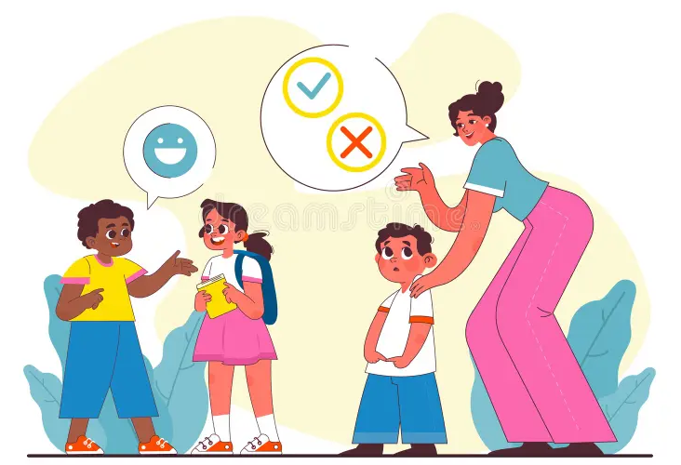
Social interaction provides the means via which individuals gradually become able to see themselves through the eyes of others, learning who they are and how they fit into the world around.
Individuals have to learn the basics of both material and nonmaterial culture, everything from how to dress to what is suitable attire for a specific occasion; from when to sleep to what they sleep on; and from what is considered appropriate to eat for dinner to how to use the stove to prepare it.
Most importantly, they have to learn language—whether it is the dominant language or one common in a subculture, whether it is verbal or through signs—in order to communicate and to think.

Slide 6
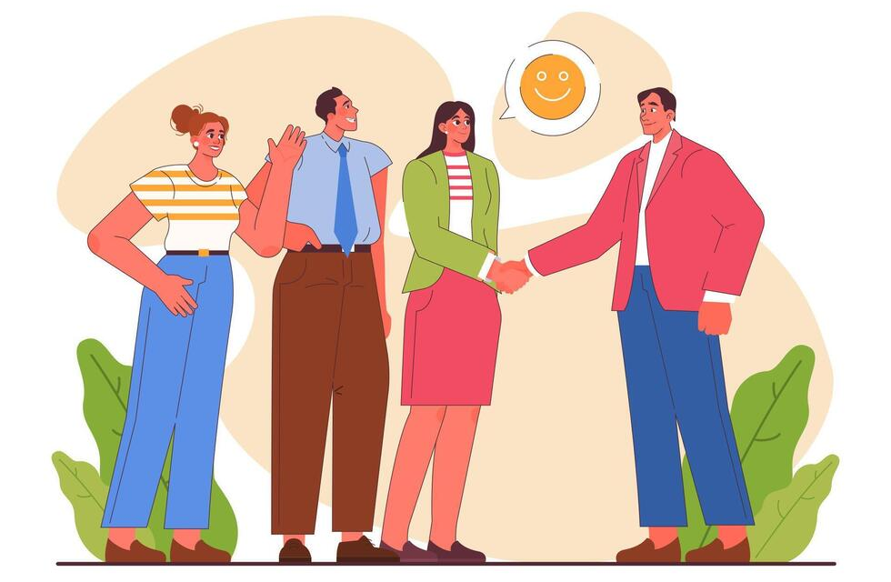
What does socialization teach?
Language
Culture (norms, values, beliefs, etc.)
Understanding of others
Understanding of ourselves as a social beings

Slide 7

The role of nature and nurture
Socialization is important because it helps uphold societies and cultures; it is also a key part of individual development.
Research demonstrates that who we are is affected by both nature (our genetic and hormonal makeup) and nurture (the social environment in which we are raised).

Slide 8
Sociological Theories of Self Development

Slide 9

Looking Glass Self

Slide 10
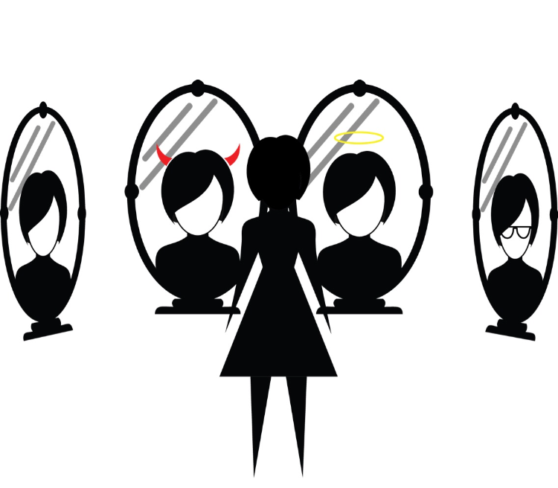
Looking Glass Self
One of the pioneering contributors to sociological perspectives on self-development was Charles Cooley (1864–1929). He asserted that people’s self understanding is constructed, in part, by their perception of how others view them—a process termed “the looking glass self” (Cooley 1902).
The self or “self idea” is thoroughly social. It is based on how we imagine we appear to others. This projection defines how we feel about ourselves and who we feel ourselves to be.
The development of a self therefore involves three elements in Cooley’s analysis:
1. The imagination of our appearance to the other person;
2. The imagination of his judgment of that appearance, and
3. Some sort of self-feeling, such as pride or mortification.

Slide 11
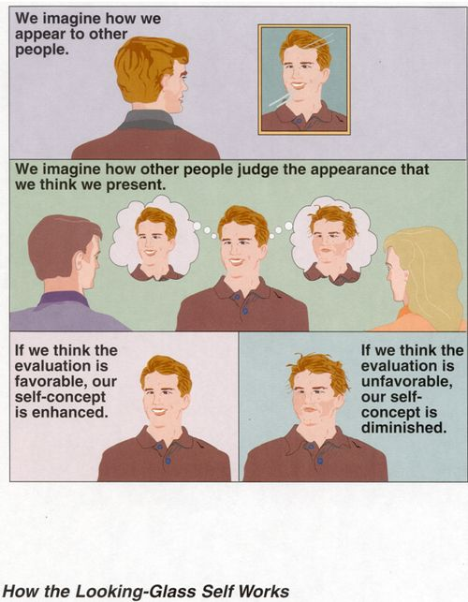

Slide 12
George Herbert Mead’s Theory of Self
Later, George Herbert Mead (1863–1931) advanced a more detailed sociological approach to the self. He agreed that the self, as a person’s distinct identity, is only developed through social interaction. He further noted that the crucial component of the self is its capacity for self reflection, its capacity to be “an object to itself” (Mead 1934).
On this basis, he broke the self down into two components or “phases,” the “I” and the “me.”
The “I,” represents the part of the self that acts on its own initiative or responds to the organized attitudes of others. It is the novel, spontaneous, unpredictable part of the self: the part of the self that embodies the possibility of change or undetermined action.
The “me”, on the other hand, represents the part of the self in which one recognizes the “organized sets of attitudes” of others toward the self. It is who we are in other’s eyes: our roles, our “personalities,” our public personas.

Slide 13
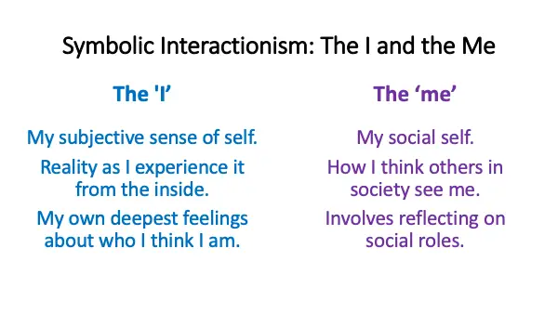

Slide 14
Kohlberg’s Theory of Moral Development
Lawrence Kohlberg (1927–1987) was interested in how people learn to decide what is right and what is wrong. He developed a theory of moral development that includes three levels: preconventional, conventional, and postconventional.
In the preconventional stage, young children, who lack a higher level of cognitive ability, experience the world around them only through their senses.
It isn’t until the teen years that the conventional theory develops, when youngsters become increasingly aware of others’ feelings and take those into consideration when determining what’s “good” and “bad.”
The final stage, called postconventional, is when people begin to think of morality in abstract terms, such as believing that everyone has the right to life, liberty, and the pursuit of happiness. At this stage, people also recognize that legality and morality do not always match up evenly.
Moral development refers to the way people learn what society considered to be “good” and “bad,” which is important for a smoothly functioning society. It prevents people from acting on unchecked urges, instead considering what is right for society and good for others.

Slide 15
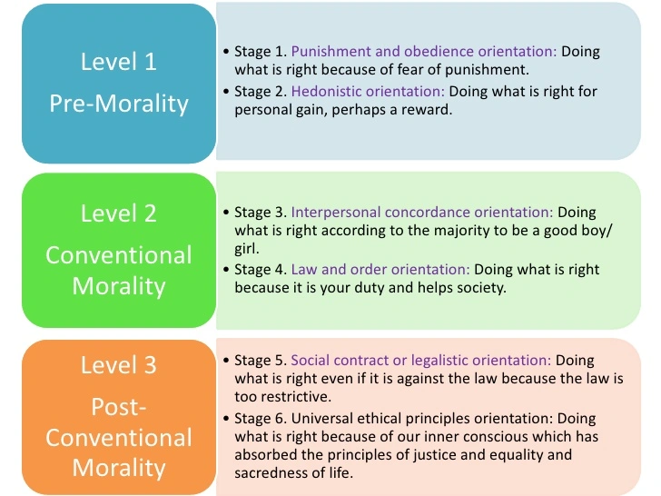
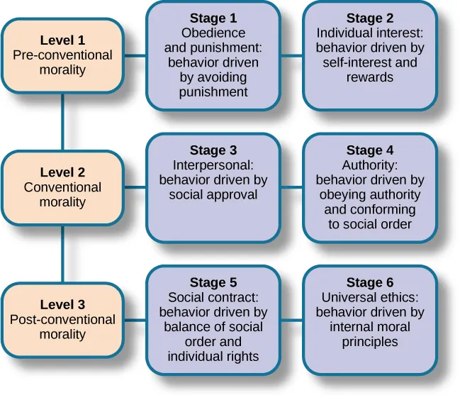

Slide 16
Gilligan’s Theory of Moral Development and Gender
Another sociologist, Carol Gilligan (1936–), recognized that Kohlberg’s theory might show gender bias since his research was conducted only on male subjects. She studied differences between how boys and girls developed morality.
Gilligan’s research demonstrated that boys and girls do, in fact, have different understandings of morality. Boys tend to have a justice perspective, placing emphasis on rules and laws. Girls, on the other hand, have a care and responsibility perspective; they consider people’s reasons behind behavior that seems morally wrong.
Gilligan also recognized that Kohlberg’s theory rested on the assumption that the justice perspective was the right, or better, perspective. Gilligan, in contrast, theorized that neither perspective was “better”: the two norms of justice served different purposes.
Ultimately, she explained that boys are socialized for a work environment where rules make operations run smoothly, while girls are socialized for a home environment where flexibility allows for harmony in caretaking and nurturing (Gilligan 1982, 1990).

Slide 17

Agents and Agencies of Socialization
Agents and agencies of socialization are the persons, groups, or institutions that teach us what we need to know in order to participate in society.
In general, agents are people involved in our socialization while agencies represent the organizations involved in our socialization.
Socialization helps people learn to function successfully in their social worlds.
Notes:
http://www.uop.edu.pk/ocontents/SOCIALIZATION.pdf

Slide 18
Agents of Socialization
You
Religion
Family
Peers
School
Mass Media
Work

Slide 19
Social Group Agents
Social groups often provide the first experiences of socialization.
Institutional Agents
The social institutions of our culture also form our socialization.
Families, and later peer groups, communicate expectations and reinforce norms.
People first learn to use the tangible objects of material culture in these settings, as well as being introduced to the beliefs and values of society.
Formal institutions—like schools, workplaces, and the government—teach people how to behave in and navigate these systems.
Other institutions, like the media, contribute to socialization by inundating us with messages about norms and expectations.

Slide 20

1. Family

Slide 21

Family is the first agent of socialization.
Mothers and fathers, siblings and grandparents, plus members of an extended family, all teach a child what he or she needs to know.
For example, they show the child how to use objects (such as clothes, computers, eating utensils, books, bikes); how to relate to others (some as “family,” others as “friends,” still others as “strangers” or “teachers” or “neighbors”); and how the world works (what is “real” and what is “imagined”).

Slide 22
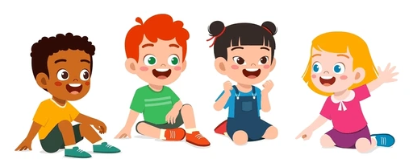
2. Peer Groups

Slide 23
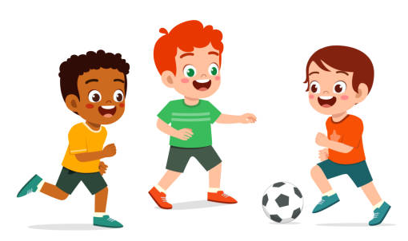
A peer group is made up of people who are similar in age and social status and who share interests.
Peer group socialization begins in the earliest years, such as when kids on a playground teach younger children the norms about taking turns or the rules of a game or how to shoot a basket. As children grow into teenagers, this process continues.
Peer groups are important to adolescents in a new way, as they begin to develop an identity separate from their parents and exert independence. Additionally, peer groups provide their own opportunities for socialization since kids usually engage in different types of activities with their peers than they do with their families.
Peer groups provide adolescents’ first major socialization experience outside the realm of their families.
The term “peer pressure” is used to describe instances where an individual feels indirect pressured into changing their behavior to match that of their peers.

Slide 24

3. Mass Media

Slide 25

Refers to the distribution of impersonal information via television, newspapers, radio, and the internet that are directed to mass audiences.
Mass media can be a positive or negative agent of socialization.
Television, movies, and cartoons: Reflecting women’s changing position in society, cartoons now feature more dominant, aggressive female. E.g., the Powerpuff Girls
A key part of gender is body image, and the mass media are effective in teaching us what we “should” look like. One’s personal appearance may be influenced.
Can be an agent to discover new cultures.
People learn about objects of material culture (like new technology and transportation options), as well as nonmaterial culture—what is true (beliefs), what is important (values), and what is expected (norms).

Slide 26

4. Schools

Slide 27

When children attend schools and daycares, they receive instruction and socialization outside the family.
Students are not only in school to study math, reading, science, and other subjects—the manifest function of this system. Schools also serve a latent function in society by socializing children into behaviors like teamwork, following a schedule, and using textbooks.
School and classroom rituals, led by teachers serving as role models and leaders, regularly reinforce what society expects from children. Sociologists describe this aspect of schools as the hidden curriculum, the informal teaching done by schools.
Students learn to evaluate themselves within a hierarchical system as “A,” “B,” “C,” etc. students (Bowles and Gintis 1976). However, different “lessons” can be taught by different instructional techniques. When children participate in a relay race or a math contest, they learn that there are winners and losers in society. When children are required to work together on a project, they practice teamwork with other people in cooperative situations. Bowles and Gintis argue that the hidden curriculum prepares children for a life of conformity in the adult world.
Children learn how to deal with bureaucracy, rules, expectations, waiting their turn, and sitting still for hours during the day. The latent functions of competition, teamwork, classroom discipline, time awareness and dealing with bureaucracy are features of the hidden curriculum.
Notes:
https://study.com/learn/lesson/agents-of-socialization-types-examples.html

Slide 28

5. Religion

Slide 29
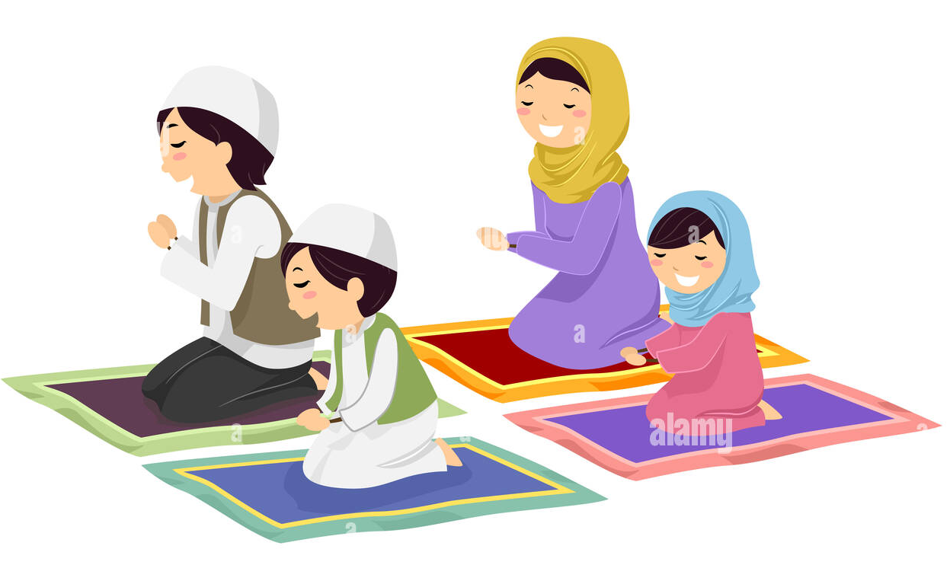
Religion is an important avenue of socialization for many people.
It teaches people moral behavior and thus helps them learn how to be good members of society.
Encourages charity.
Teach responsibility of others.
These places teach participants how to interact with the religion’s material culture (like a prayer rug). For some people, important ceremonies related to family structure—like marriage and birth—are connected to religious celebrations.
Many of these institutions uphold gender norms and contribute to their enforcement through socialization. From ceremonial rites of passage that reinforce the family unit, to power dynamics which reinforce gender roles, religion fosters a shared set of socialized values that are passed on through society.

Slide 30

6. Workplace

Slide 31


Workers require new socialization into a workplace, both in terms of material culture (such as how to operate the copy machine) and nonmaterial culture (such as whether it is okay to speak directly to the boss or how the refrigerator is shared).
Can teach how to collaborate with diverse group of people.
Individuals are actively setting goals and achieving them.
Importance on making money and supporting a family is learned.

Slide 32

Video
https://www.youtube.com/watch?v=O5pZmNdW_xs
Notes:
https://www.youtube.com/watch?v=O5pZmNdW_xs

Slide 33

Resocialization
Resocialization is the process of learning new norms, values, attitudes, and behavior. Resocialization occurs each time we learn something contrary to our previous experiences.
Most resocialization is mild, but some are intense too. For example, adjusting to a new job or work environment, to moving to another country where you have to learn new customs, dress, language, and eating habits. Examples: divorce, switching a new job, etc.
In the process of resocialization, old behaviors that were helpful in a previous role are removed because they are no longer of use.
Resocialization is necessary when a person moves to a senior care center, goes to boarding school, or serves time in jail. In the new environment, the old rules no longer apply. The process of resocialization is typically more stressful than normal socialization because people have to unlearn behaviors that have become customary to them.

Slide 34
Voluntary vs. Involuntary Resocialization
Most resocialization is voluntary, but some, as with residents of total institutions, is involuntary.
Voluntary
Involuntary
Individuals choose to assume a new status
Religious conversion
Moving to a new country and adapting
Joining the military
Against a person’s wishes
Prison
Mandatory counselling
Drug rehabilitation
Many individuals are resocialized into an institution through a two-part process. First, members entering an institution must leave behind their old identity through what is known as a degradation ceremony.
In a degradation ceremony, new members lose the aspects of their old identity and are given new identities. The process is sometimes gentle. To enter a senior care home, an elderly person often must leave a family home and give up many belongings which were part of his or her long-standing identity. Though caretakers guide the elderly compassionately, the process can still be one of loss.

Slide 35
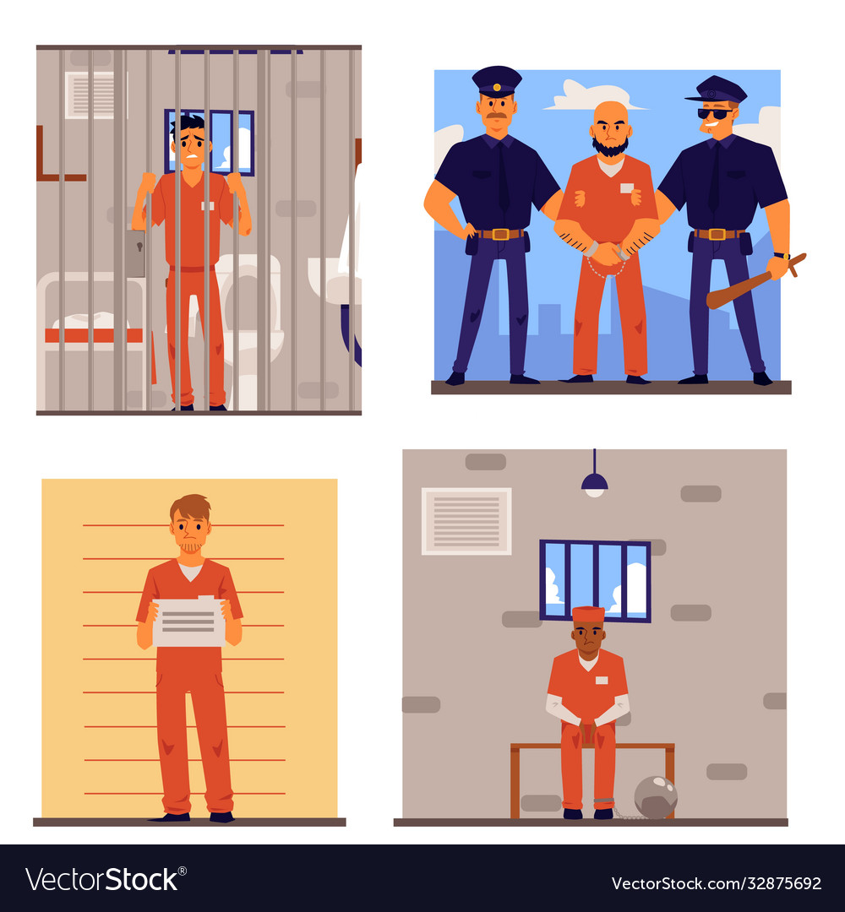
In other situations, the degradation ceremony can be more extreme. Goffman refered to the process of being stripped of ones external identity as a “mortification of the self” (Goffman 1961). New prisoners lose freedom, rights (including the right to privacy), and personal belongings. When entering the army, soldiers have their hair cut short. Their old clothes are removed and they wear matching uniforms. These individuals must give up any markers of their former identity in order to be resocialized into an identity as a “soldier.”
After new members of an institution are stripped of their old identity, they build a new one that matches the new society. In the military, soldiers go through basic training together, where they learn new rules and bond with one another. They follow structured schedules set by their leaders. Soldiers must keep their areas clean for inspection, learn to march in correct formations, and salute when in the presence of superiors. Learning to deal with life after having lived in a total institution requires yet another process of resocialization.

Slide 36
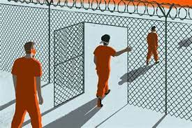
Total Institutions
The most common way resocialization occurs is in a total institution where people are isolated from society and are forced to follow someone else’s rules. A ship at sea is a total institution, as are religious convents, prisons, or some cult organizations. They are places cut off from a larger society. As another example, every branch of the military is a total institution.
Sociologist Erving Goffman (1961) coined this term to refer a place that is almost totally controlled by those who run it, in which people are cut off from the rest of society and the society is mostly cut off from them. Examples: prisons, mental hospitals, rehab facilities and the military.
Total institutions are isolated from the public. Example: In prison, the bars, walls, gates, and guards not only keep the inmates in but also keep outsiders out. Staff members supervise the day-to-day lives of the residents. Eating, sleeping, showering, recreation-all are standardized. Inmates learn that their previous statuses- student, worker, spouse, parent, now mean nothing. The only thing that counts is their current status.
It’s a part of the resocialization process that includes the loss of some decision-making freedom. Such as the military decides what its soldiers wear, how they spend their time, and when and what they eat.

Slide 37
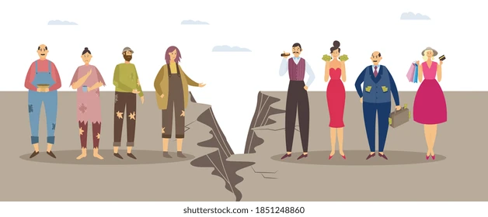

Sociologists all recognize the importance of socialization for healthy individual and societal development. Structural functionalists would say that socialization is essential to society, both because it trains members to operate successfully within it and because it perpetuates culture by transmitting it to new generations. Without socialization, a society’s culture would perish as members die off.
A critical sociologist might argue that socialization reproduces inequality from generation to generation by conveying different expectations and norms to those with different social characteristics. For example, individuals are socialized differently by gender, social class, and race.
An interactionist studying socialization is concerned with face-to-face exchanges and symbolic communication. For example, dressing baby boys in blue and baby girls in pink is one small way that messages are conveyed about differences in gender roles.

Slide 38
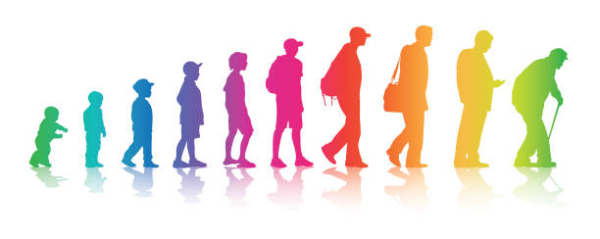
Socialization Across the Life Course
Socialization is a lifelong process. Our life course is determined greatly by age norms and time-related rules and regulations. As we grow older, we encounter age-related transition points that require socialization into a new role, such as becoming school age, entering the workforce, or retiring.
Many of life’s social expectations are made clear and enforced on a cultural level. Through interacting with others and watching others interact, the expectation to fulfill roles becomes clear.

Slide 39
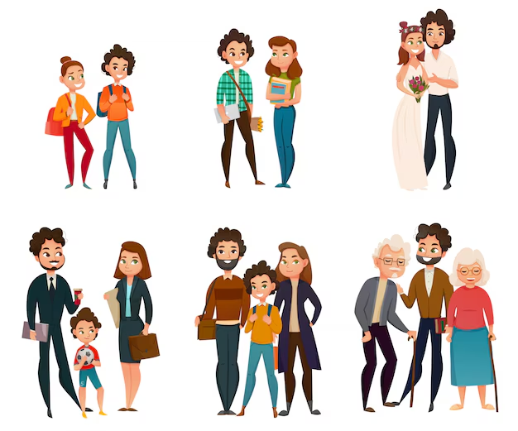
The socialization that takes place in high school changes the expectation. By observing the excitement and importance attached to dating and relationships within the high school social scene, it quickly becomes apparent that one is now expected not only to be a child and a student, but a significant other as well.
Graduation from formal education—high school, vocational school, or college—involves socialization into a new set of expectations. In the process of socialization, adulthood brings a new set of challenges and expectations, as well as new roles to fill. As the aging process moves forward, social roles continue to evolve.
Pleasures of youth become less acceptable in the eyes of society. Responsibility and commitment are emphasized as pillars of adulthood, and men and women are expected to “settle down.”
During this period, many people enter into marriage or a civil union, bring children into their families, and focus on a career path. They become partners or parents instead of students or significant others.

